Slide 1
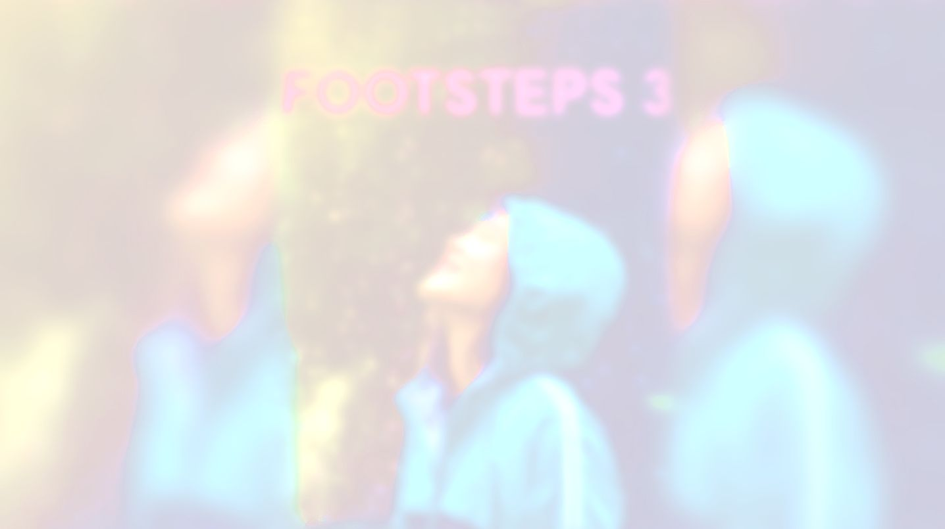


UNIT 2;
Time to enjoy
Self-check 2

Slide 2
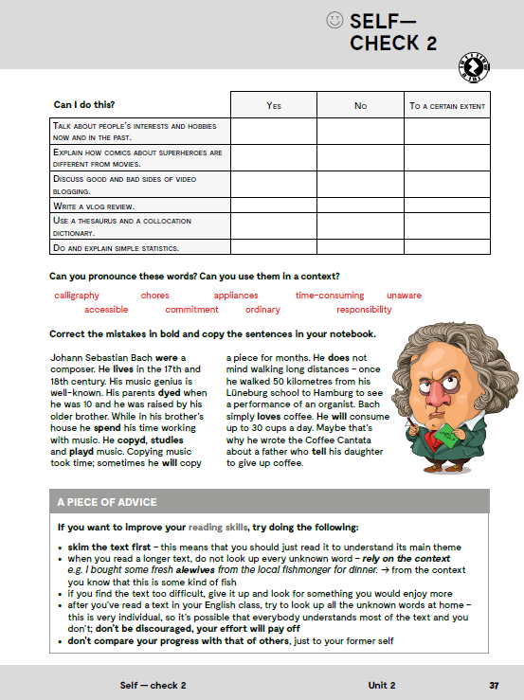
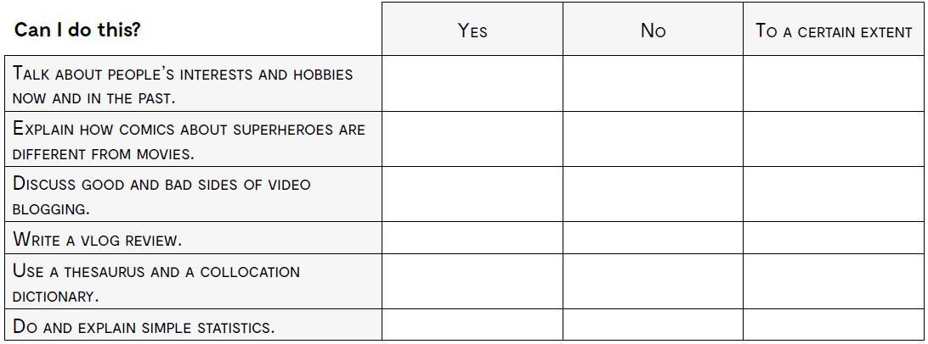
Can you do this?
govoriti o interesima i hobijima ljudi sada i u prošlosti?
objasniti kako se stripovi o superhorojima razlikuju od filmova?
diskutirati o dobrim i lošim stranama video blogginga?
napisati recenziju za video blog?
koristiti thesaurus i kolokacijski rječnik?
izračunati i objasniti jednostavnu statistiku?

Slide 3
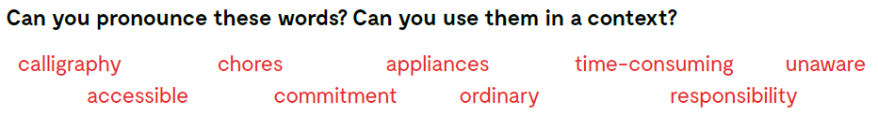
calligraphy krasopis
chores dužnosti, kućanski poslovi
appliances kućanski aparati
time-consuming onaj koji troši vrijeme
unaware nije svjestan
accessible dostupan
commitment obveza
ordinary jednostavan, običan
responsibility dužnost

Slide 4
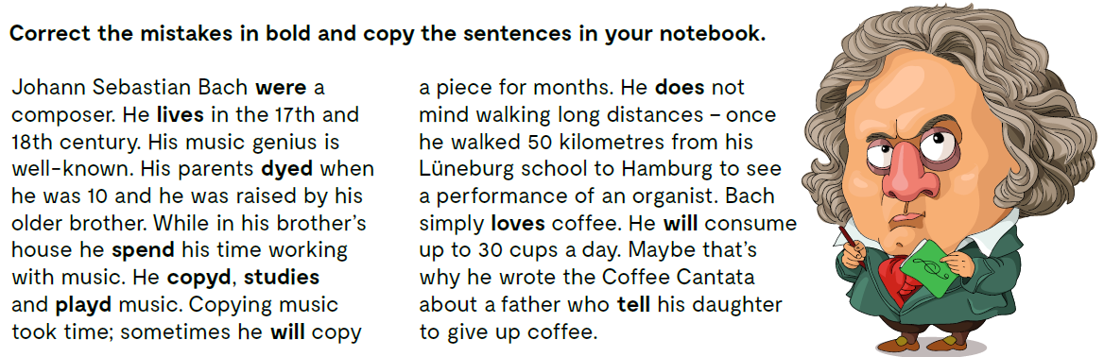
Johann Sebastian Bach was a composer. He lived in the 17th and 18th century...

Slide 5
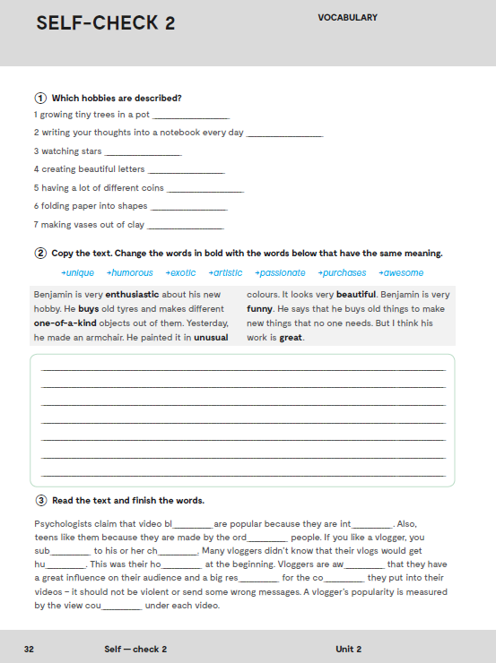
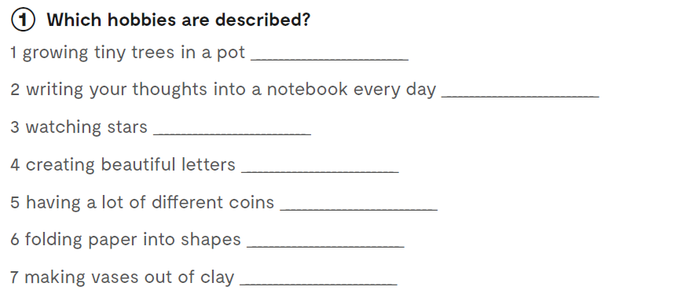
Workbook, p 32
doing bonsai trees
keeping a diary
astronomy
calligraphy
collecting coins
origami
pottery

Slide 6
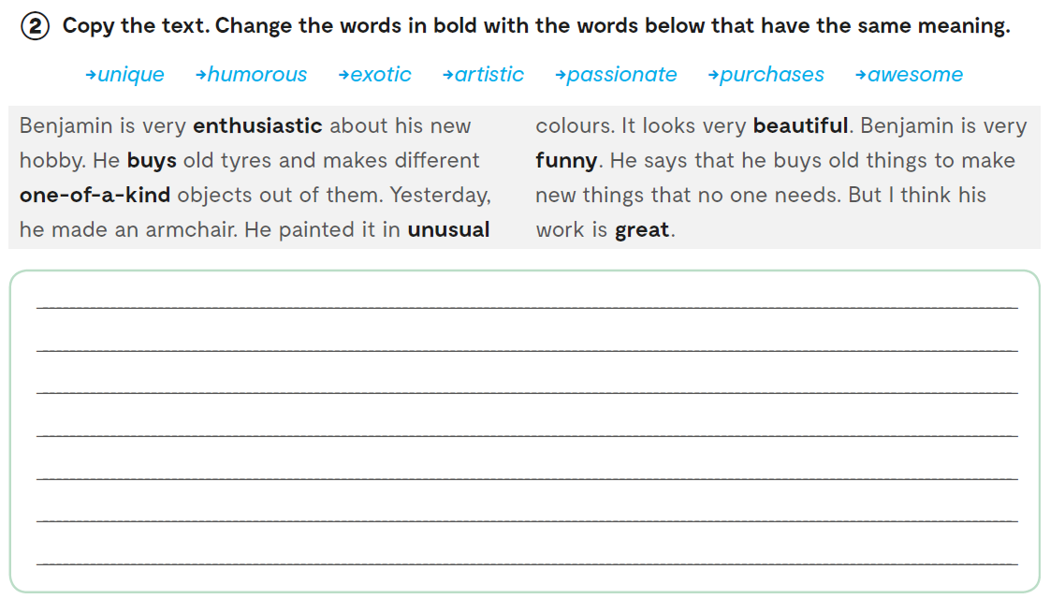
Benjamin is very passionate about his new hobby.
He purchases old tyres and makes different unique objects out of them.
Yesterday, he made an armchair. He painted it in exotic colours.
It looks very artistic.
Benjamin is very humorous.
He says that he buys old things to make new things that no one needs.
But I think his work is awesome.

Slide 7
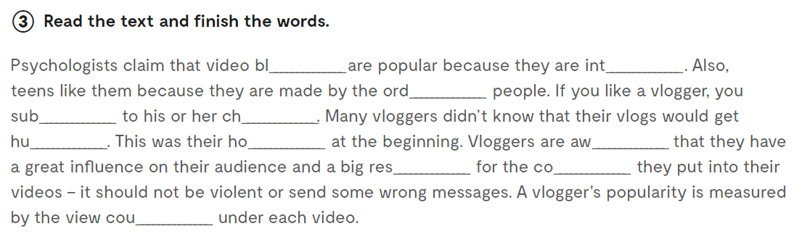
ogs
eresting
inary
scribe
annel
ge
bby
are
ponsibility
ntent
nt

Slide 8
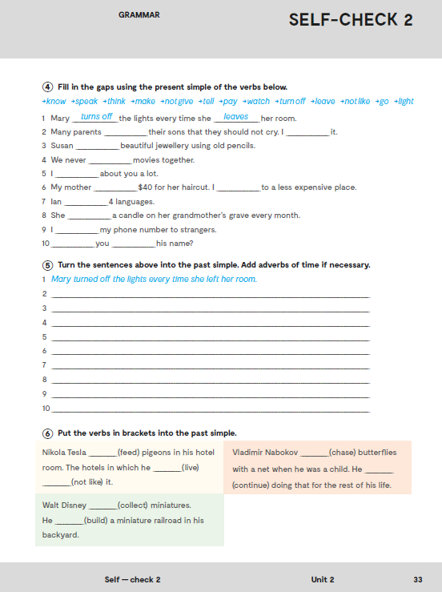
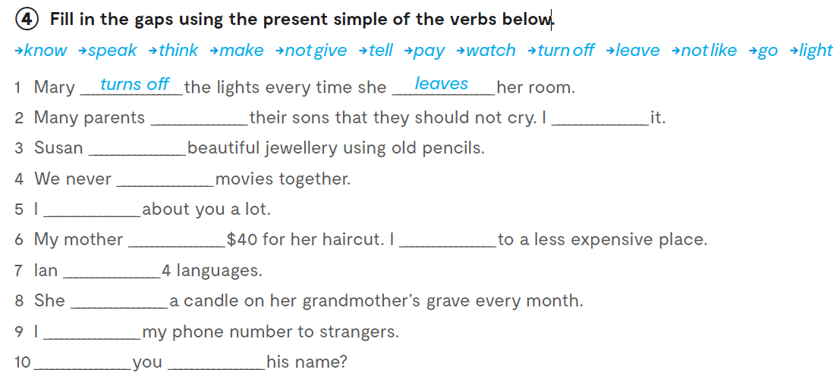
tell
don’t like
makes
watch
think
pays
go
speaks
lights
don’t give
Do know

Slide 9
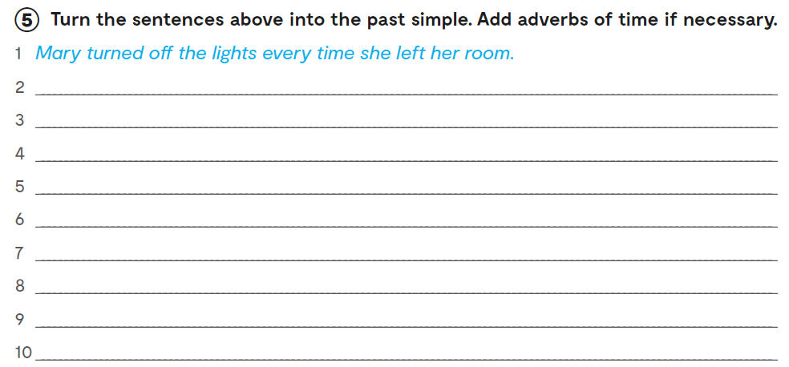
Many parents told their sons that they should not cry. I didn’t like it.
Susan made beautiful jewellery using old pencils.
We never watched movies together.
I thought about you a lot.
My mother paid 40$ for her hair-cut. I went to some place less expensive.
Ian spoke 4 languages.
She lit a candle on her grandmother's grave last month.
I didn’t give my phone number to strangers.
Did you know his name?

Slide 10
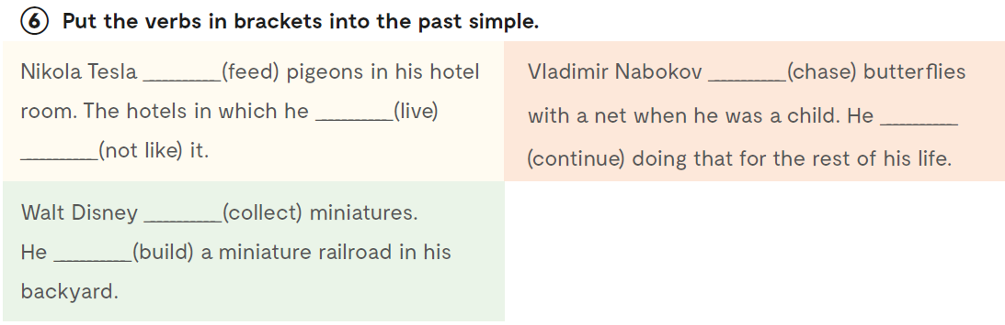
fed
chased
lived
continued
didn’t like
collected
built
Practise:
https://wordwall.net/play/885/280/122

Slide 11

